Slide 1
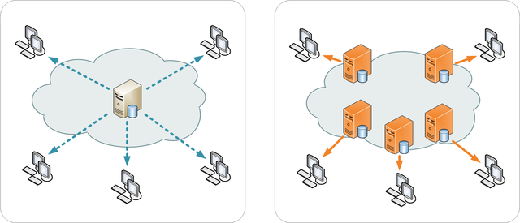
CS 5800 Final Project Optimizing Data Retrieval for Improved User Experience in an E-commerce Website
Karthik Chintamani Dileep
Karthik Jayaram Bharadwaj
Shrada Chellasami
Sankara Narayanan Rajagopal

Slide 2
Agenda
Project Introduction
Project Goal
Basic Approach and assumptions

Slide 3
Project Introduction
The topic is focused on the measures taken by a large e-commerce company, which has servers situated in different regions globally, to ensure that its website is accessible to users worldwide.
The company has observed that certain users are encountering issues such as delayed page load times and prolonged wait times while attempting to finalize transactions on the website.
To enhance the user experience by optimizing data retrieval, the company decides to adopt a strategy that involves determining the most direct path among its servers. It utilizes network monitoring tools to gather information on the network's topology, which includes the servers' location and connectivity.

Slide 4
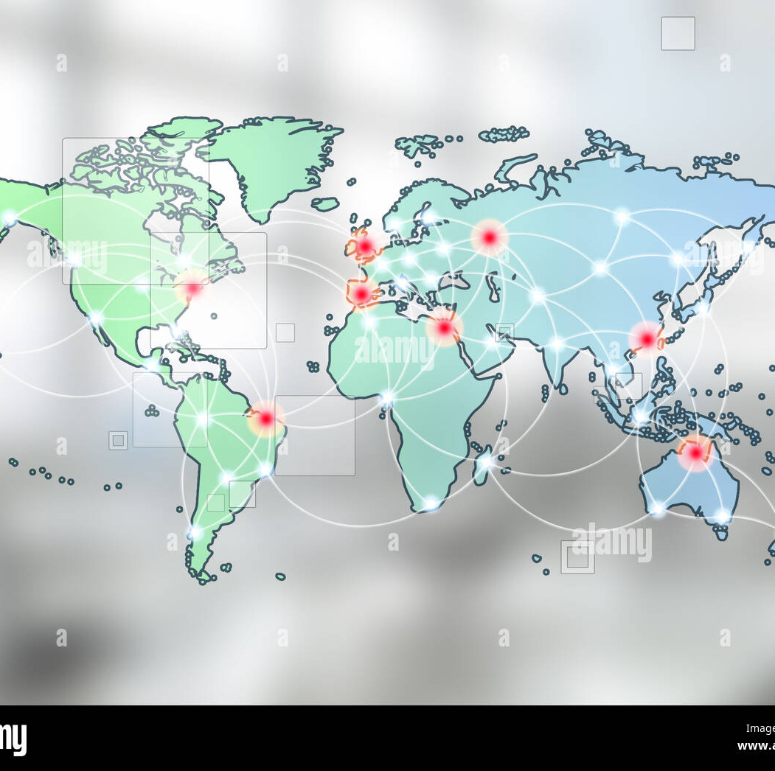
Project Goal
We have made use of algorithms such as Breadth First Search, Dijkstra’s, and Floyd Warshall to determine the shortest path from a user's location to the server that is hosting the data they are requesting. This will allow the company to route data requests more efficiently, reducing the time required for data to travel between servers and improving page load times for users.

Slide 5
Assumptions
The servers in the e-commerce website form a connected graph.
This means that there is a path between any two servers in the system, allowing for efficient data transfer between them.
Each server in the system is a node in this graph and can communicate with other nodes through the established paths.
Furthermore, we have information about the data that is stored in each server, allowing us to locate the required data efficiently.
By leveraging the interconnectedness of the servers and the knowledge of data locations, we can optimize the data retrieval process and improve user experience on the website.

Slide 6
Basic Approach
We start by using the BFS algorithm to determine the nearest server to the user and establish a connection with it.
Next, we check if the requested data is already available on the connected server’s storage or cache and serve the request from there if possible.
If the data is not available on the connected server, we refer to a lookup table that is constructed using the Floyd-Warshall algorithm.
The lookup table helps us identify neighboring servers that may have the requested data, and we check with them in a sequential manner until we find the right server.
To optimize this process, we use Dijkstra's algorithm to determine the most efficient path to reach the server that can serve the user's request.
By using these techniques, we can improve data retrieval speed and efficiency, resulting in a faster and smoother user experience on the website.

Slide 7
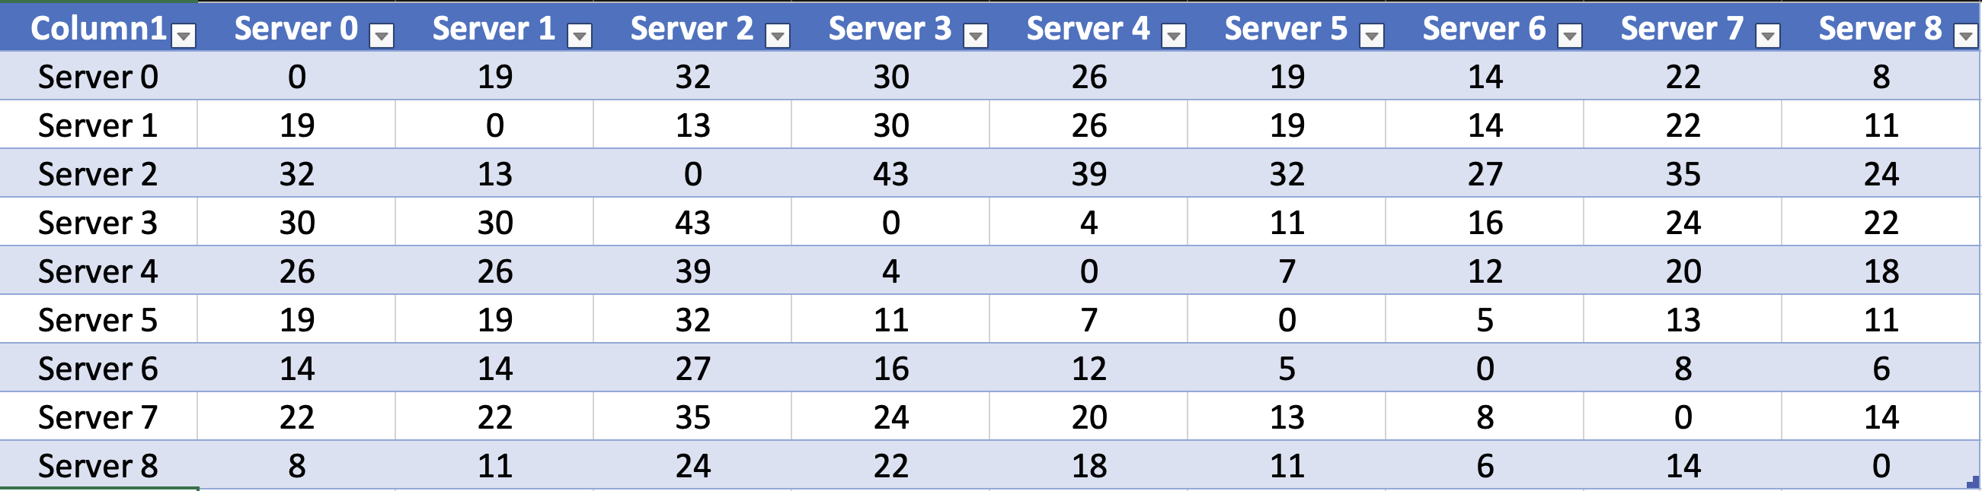
Floyd-Warshall

Slide 8
Data Lookup
Data | AB001 | AB123 | CB234 | BC120 | CB345 | DH190 | EH098 | AN390 | FH347 | AX099 | DX340 | CP120 | XN490 | CC909 | DP090 | IO901 | KK120 | DS209 | PO109 | CS190 | CI222
Server 0 | 0 | 0 | 0 | 1 | 1 | 1 | 7 | 8 | 4 | 3 | 3 | 4 | 4 | 5 | 6 | 6 | 6 | 7 | 7 | 8 | 8
Server 1 | 0 | 0 | 0 | 1 | 1 | 1 | 2 | 8 | 2 | 3 | 3 | 4 | 4 | 5 | 6 | 6 | 6 | 7 | 7 | 8 | 8
Server 2 | 0 | 0 | 0 | 1 | 1 | 1 | 2 | 2 | 2 | 3 | 3 | 4 | 4 | 5 | 6 | 6 | 6 | 7 | 7 | 8 | 8
Server 3 | 3 | 0 | 0 | 1 | 1 | 5 | 7 | 5 | 4 | 3 | 3 | 4 | 4 | 5 | 6 | 6 | 6 | 7 | 7 | 8 | 8
Server 4 | 3 | 0 | 0 | 1 | 1 | 5 | 7 | 5 | 4 | 3 | 3 | 4 | 4 | 5 | 6 | 6 | 6 | 7 | 7 | 8 | 8
Server 5 | 3 | 0 | 0 | 1 | 1 | 5 | 7 | 5 | 4 | 3 | 3 | 4 | 4 | 5 | 6 | 6 | 6 | 7 | 7 | 8 | 8
Server 6 | 0 | 0 | 0 | 1 | 1 | 5 | 7 | 5 | 4 | 3 | 3 | 4 | 4 | 5 | 6 | 6 | 6 | 7 | 7 | 8 | 8
Server 7 | 0 | 0 | 0 | 1 | 1 | 5 | 7 | 5 | 4 | 3 | 3 | 4 | 4 | 5 | 6 | 6 | 6 | 7 | 7 | 8 | 8
Server 8 | 0 | 0 | 0 | 1 | 1 | 1 | 7 | 8 | 4 | 3 | 3 | 4 | 4 | 5 | 6 | 6 | 6 | 7 | 7 | 8 | 8

Slide 9
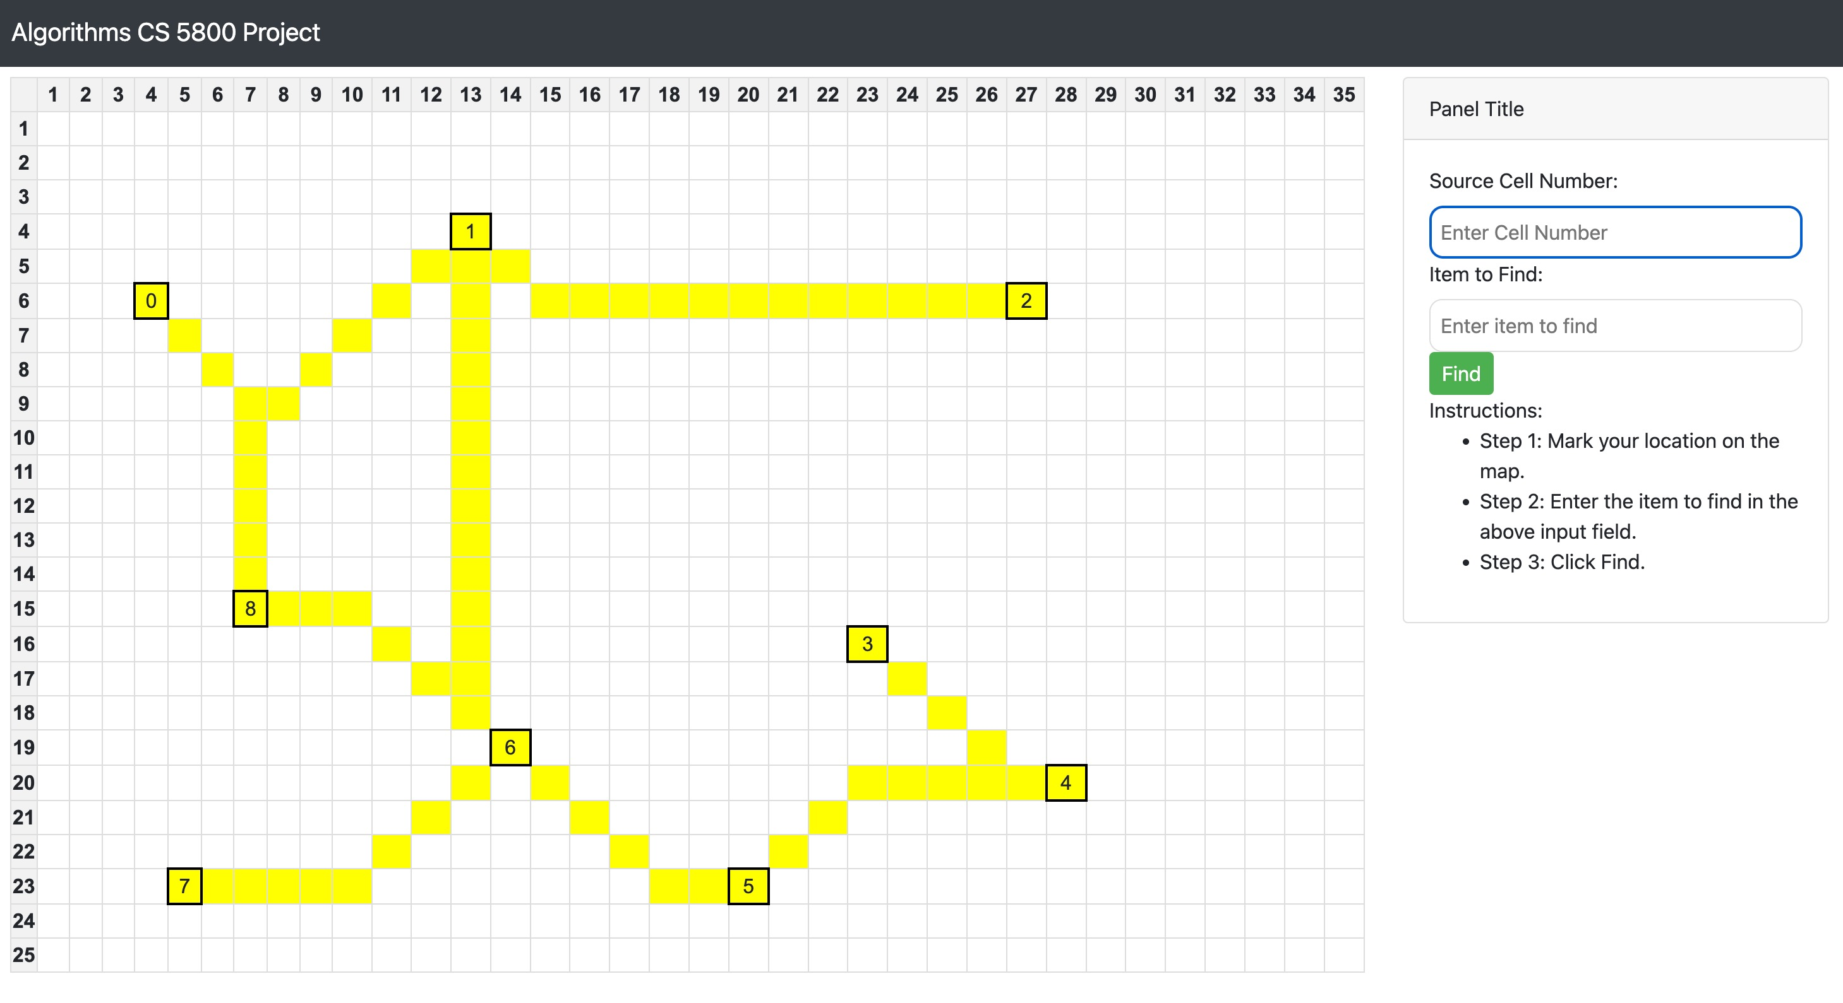

Slide 10
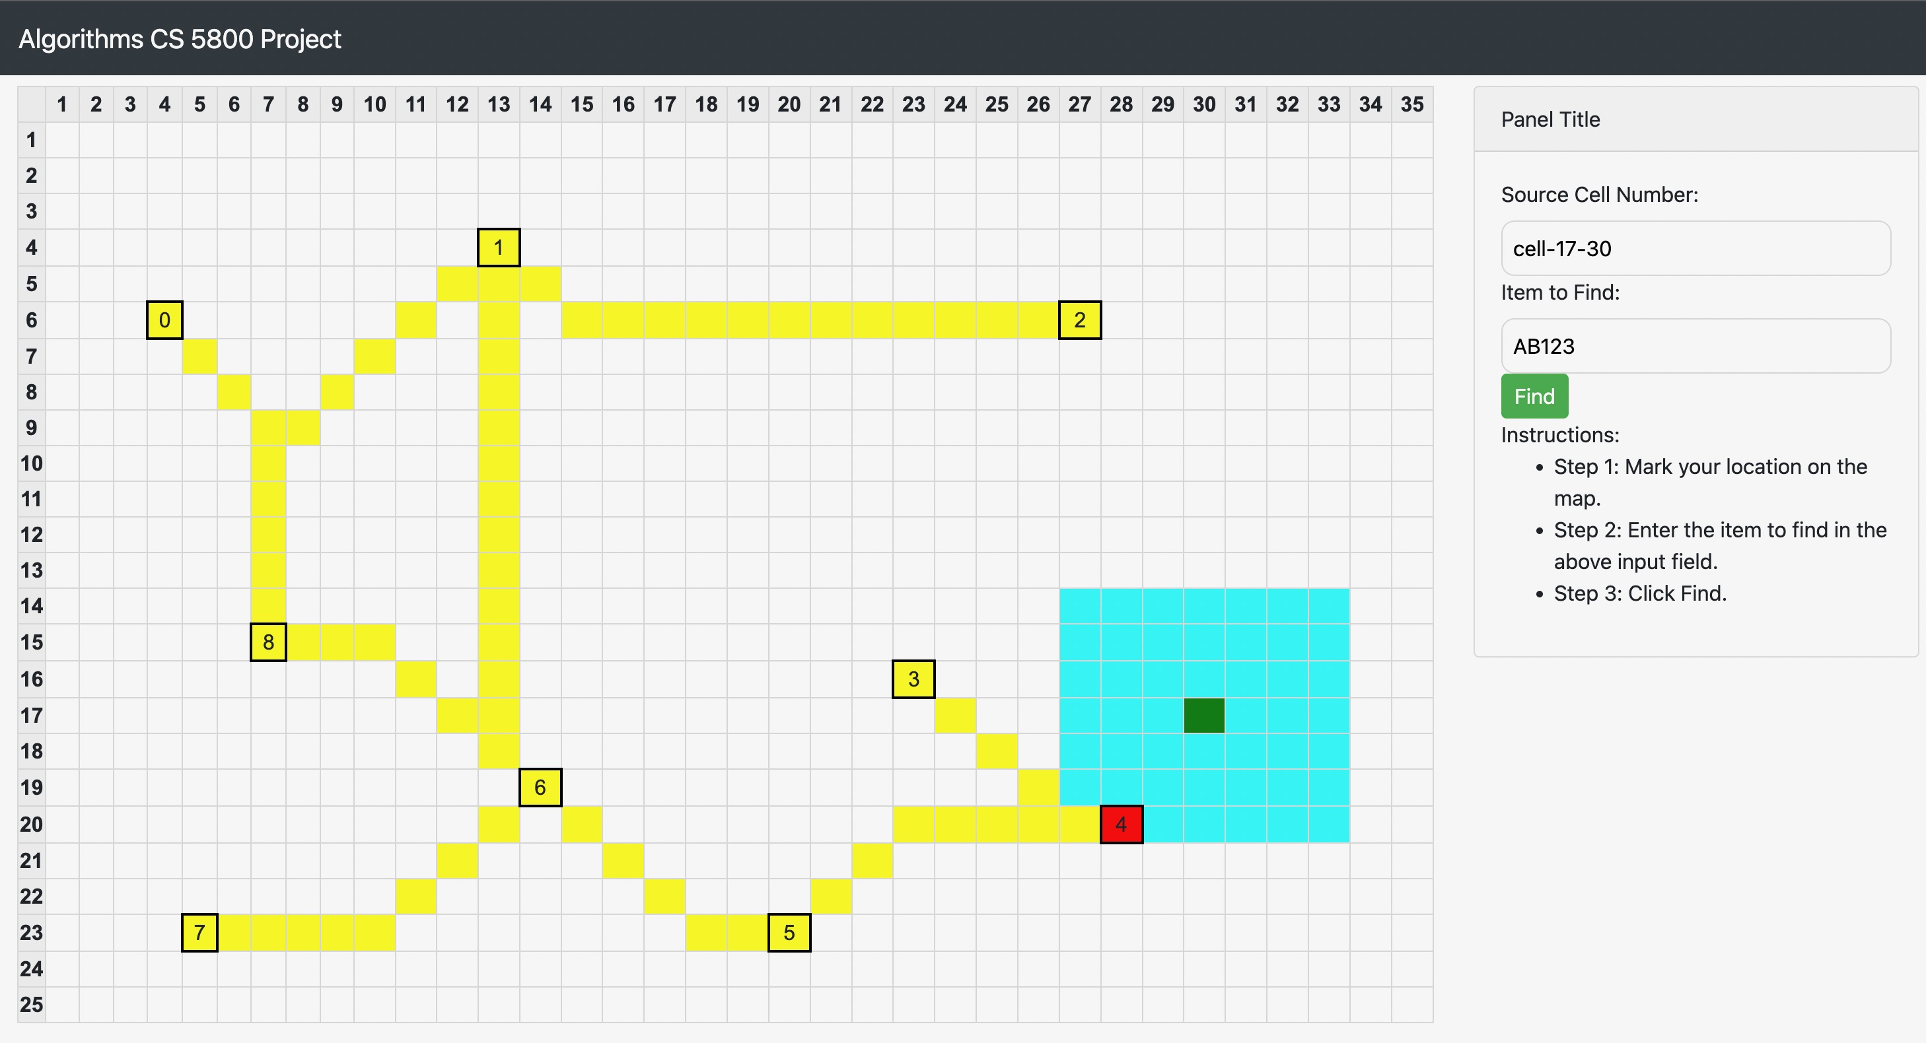
BFS

Slide 11
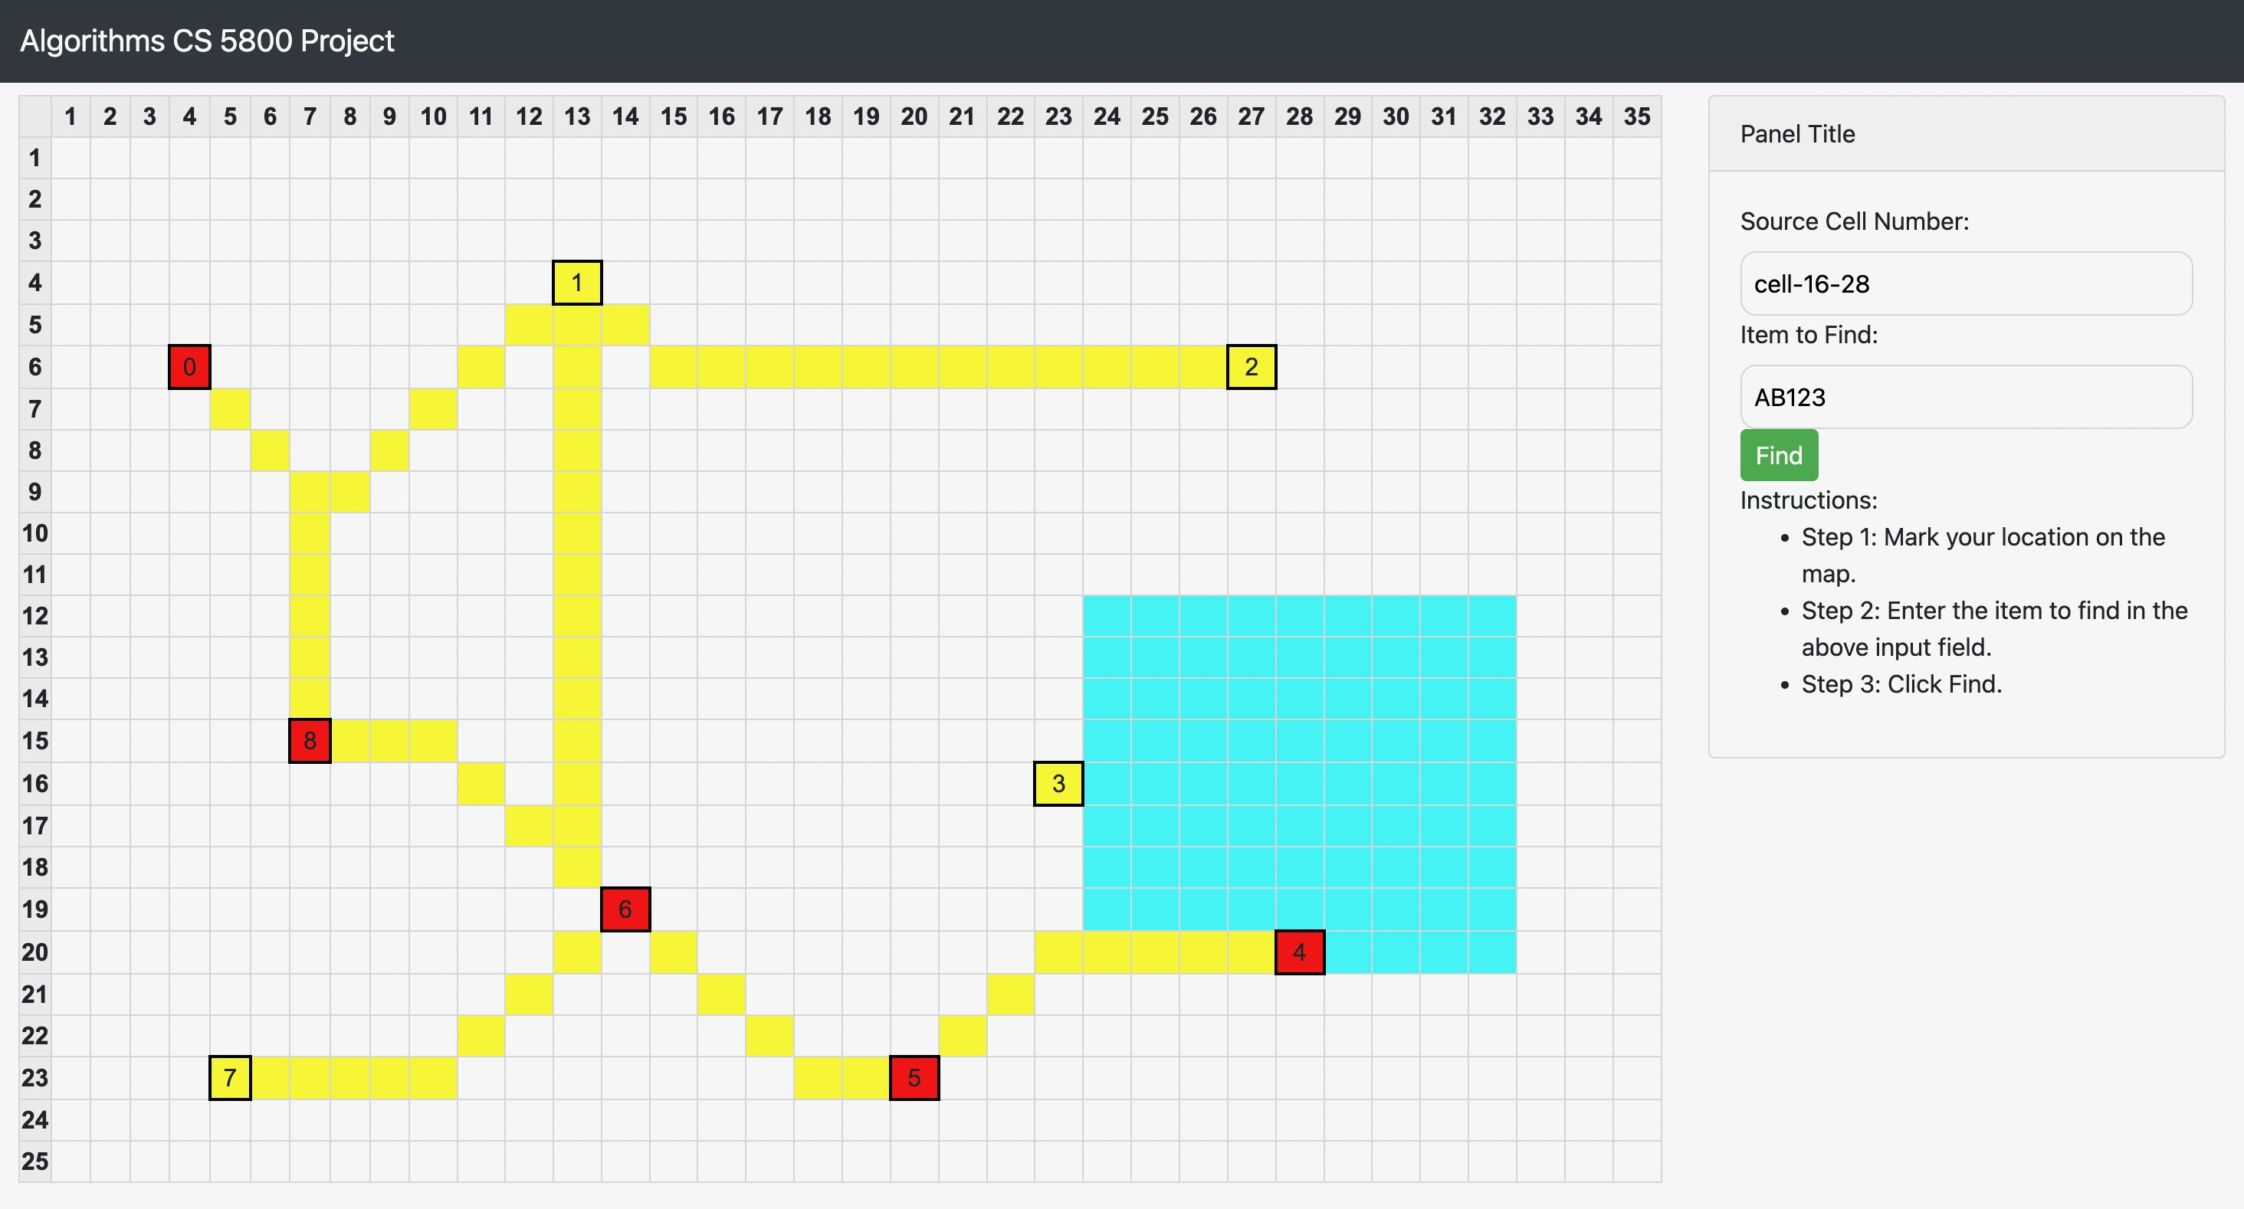
Dijkstra's algorithm

Slide 12
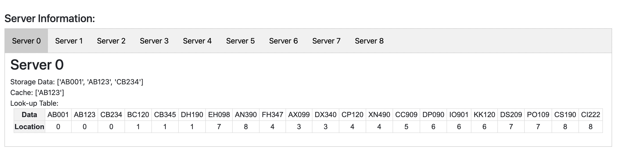

Slide 13

Demo

Slide 14
Thank You!

